Slide 1


NIMA FDB to INS Export Instructions
E&C | Internal Training | Calgary | June 1st, 2026
Obere Spichermatt 14 · 6370 Stans · Switzerland · Phone: +41-41-618-0300 · info@rosen-group.com
© 2024 ROSEN Swiss AG All Rights Reserved.
This document is the property of ROSEN Swiss AG who will safeguard its rights according to the applicable civil and criminal law provisions. No part of this document may be reproduced or disclosed to any third party without the prior written consent of ROSEN Swiss AG. The information provided in this document is for general informational purposes only and does not constitute any professional advice or any legally binding offer. While every effort has been made to ensure the accuracy of the information provided, no warranties, guarantees or representations, either expressed or implied, are made as to the completeness, accuracy, reliability, or timeliness of the information. Any data, specifications, and any other information included are subject to change without prior notice. Any liability for damages or losses including but not limited to, compensatory, direct, indirect or consequential damage, loss of income or profit, loss of or damage to property and claims by a third party resulting from the use of the information in this document is excluded to the extent permitted by law.

Slide 2
FDB Template Vs. Project FDB
FDB Template: Client specific NIMA Report template pre-configured for exporting INS defined RS_FEAT and RS_REFR
Path: E:\INS\FDB_Templates_to_RS_Output\<Client>\<version>\
Project FDB: Project specific final FDB used by EVA for generating client pipe tally
Example storage path from EVA
  E.g. N:\Proj0\<#####>\<Lineshort>\Report\
Save a copy into INS projects folder
  E.g. I:\Projects\18108 Pembina USA\04_Assessments\12TAMMAS BSL1\1_Current Inspection Data

Slide 3
1. Obtain Feature Database (FDB) from EVA Used for FR
Obtain a copy of the project FDB used by EVA for client pipe tally
  E.g. N:\Proj0\18108\12TAMMAS\Report\
Save a copy of the FDB into the INS projects folder in i-drive.
  E.g. I:\Projects\18108 Pembina USA\04_Assessments\12TAMMAS BSL1\1_Current Inspection Data\FDB_to_rs_output_conversion

Slide 4
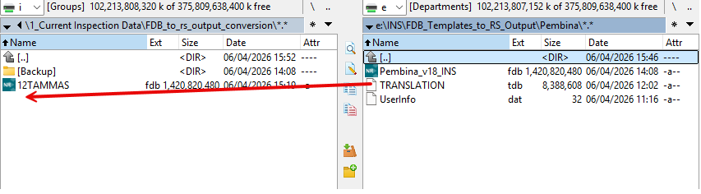
2. Copy over TRANSLATION from FDB Template Folder
Translations
Locate the client specific FDB template from E:\INS\FDB_Templates_to_RS_Output
Copy and paste the TRANSLATION file from E-drive into where the project FDB is saved in I-drive

Slide 5
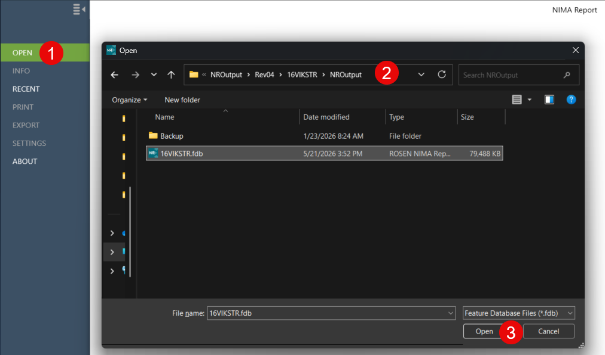
3. Open FDB using NIMA Report
Download NIMA Report 2.2.X from the Software Center and open it from the windows start menu
OPEN
Navigate to the project folder where the project FDB is saved
Open project FDB

Slide 6
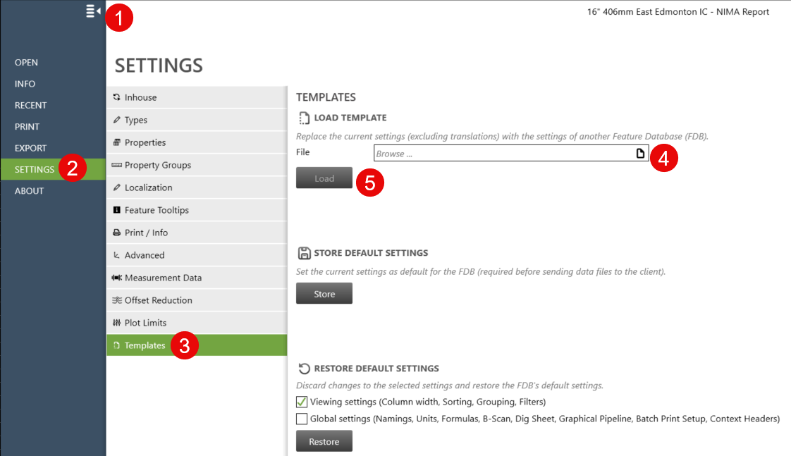

4. Load INS Export Template
Backstage View
SETTINGS
Templates
Select the client specific FDB template saved in E:\INS\FDB_Templates_to_RS_Output
Load
Close

Slide 7
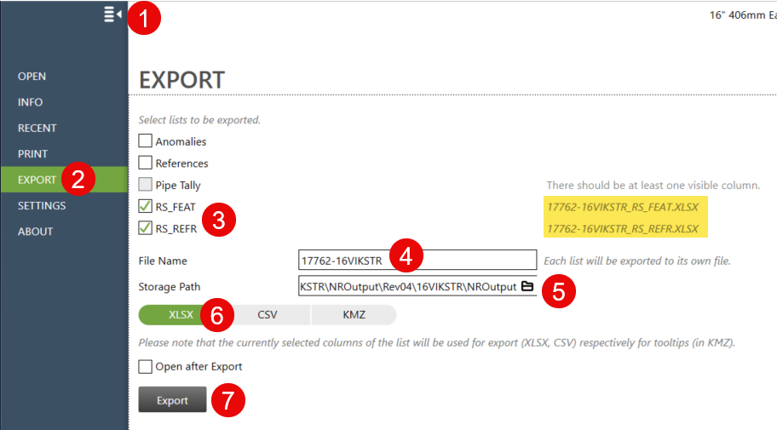
5. Export RS_REFR and RS_FEAT in XLSX
Backstage View
Export
Check RS_FEAT & RS_REFR
File Name (e.g., #####-Lineshort)
Storage Path (e.g. I-drive)
XLSX file format
Click ‘Export’

Slide 8
6. Copy/Paste Values from XLSX into RS_FEAT.dbf and RS_REFR.dbf
Open RS_FEAT.XLSX and check the values for correct formatting
Copy paste information into a blank RS_FEAT.dbf in the project folder
Repeat for RS_REFR.XLSX into a blank RS_REFR.dbf in the project folder

